Slide 1

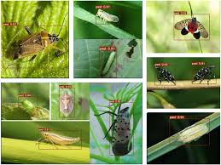


Comparative Analysis of Deep Neural Network Techniques for Automated Pest Detection on Edge Devices
Submitted by Hyder P, Mansi Sharma, Vatsalya Tiwari, Soumil M
Guide: Dr. Nirmala Shinde
Somaiya Vidyavihar University | Academic Year 2025-26

Slide 2
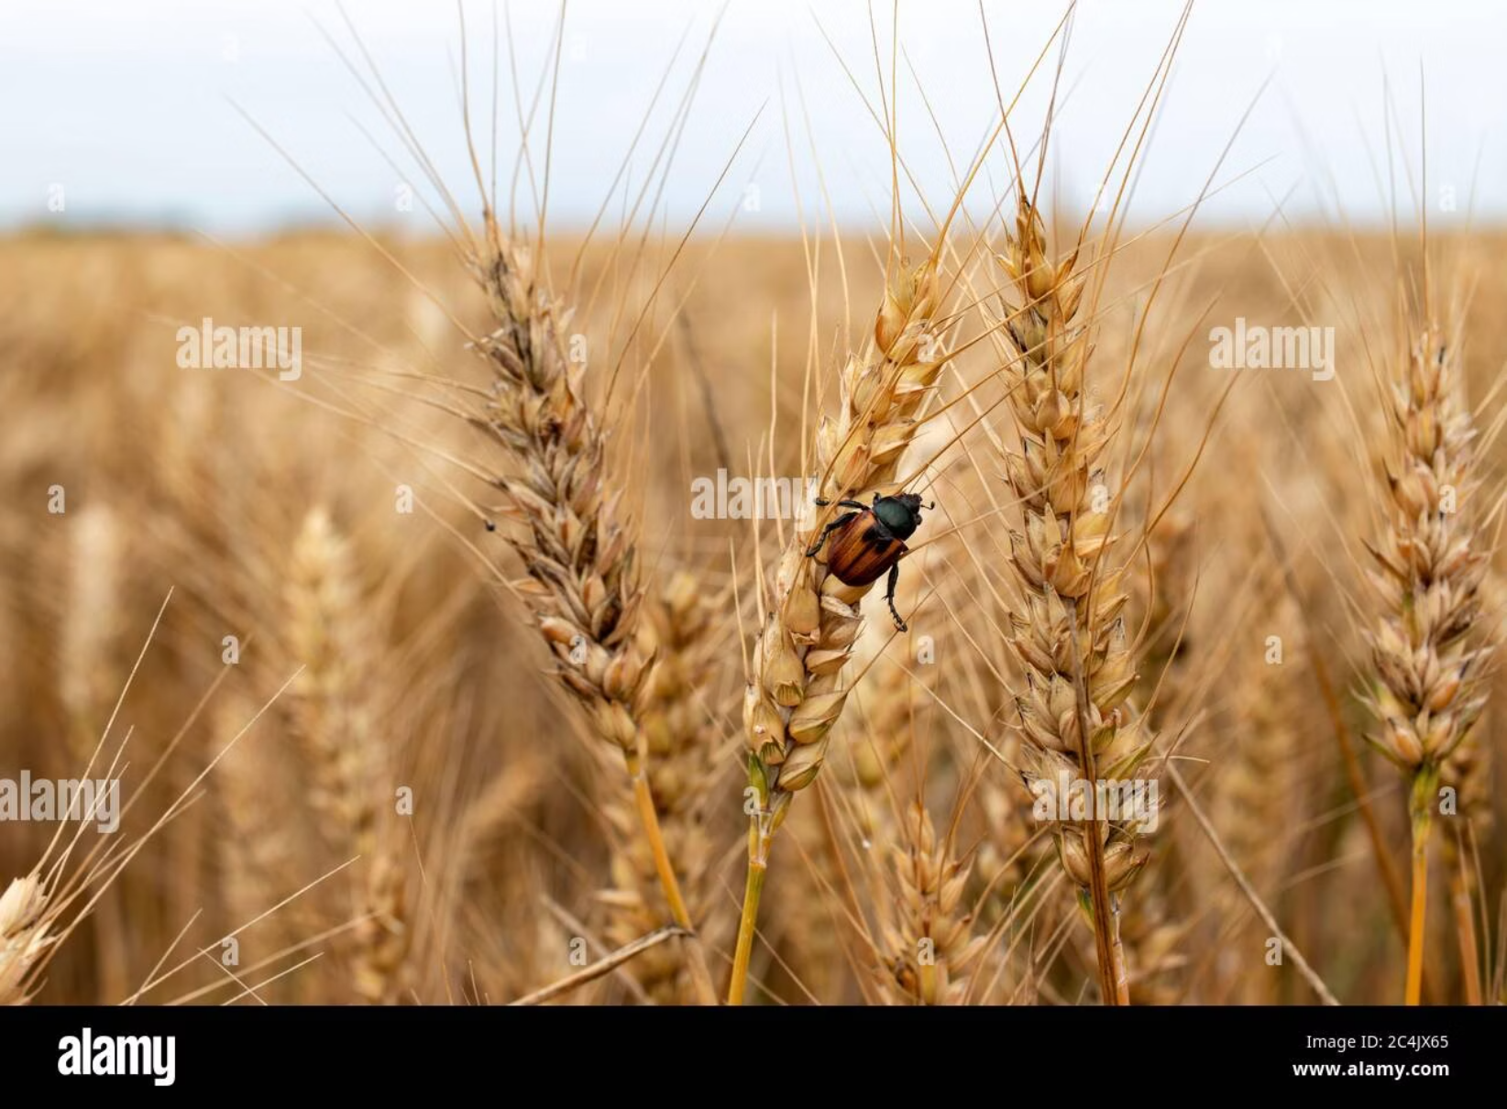
The Agricultural Challenge
By 2050
Global population projected to reach 9.7 billion, requiring a doubling of crop productivity to meet food demands.
Current Losses
Pest infestation causes 20-40% of annual crop losses worldwide, threatening food security and farmer livelihoods.
Traditional manual inspection methods are resource-intensive, subjective, and impractical for large-scale monitoring. Deep Learning offers a transformative solution through automated, real-time pest detection systems deployed directly in the field.

Slide 3




Three Neural Architectures Under Analysis
Modified LeNet-5
VGG16
MobileNetV2
A lightweight 7-layer CNN optimized for speed and energy efficiency on resource-constrained devices. Simple architecture with ReLU activation.
A deep 16-layer architecture using small 3×3 convolutional filters stacked to great depth, designed for maximum classification accuracy.
Modern mobile-optimized architecture using inverted residuals and depthwise separable convolutions for efficient edge deployment.

Slide 4
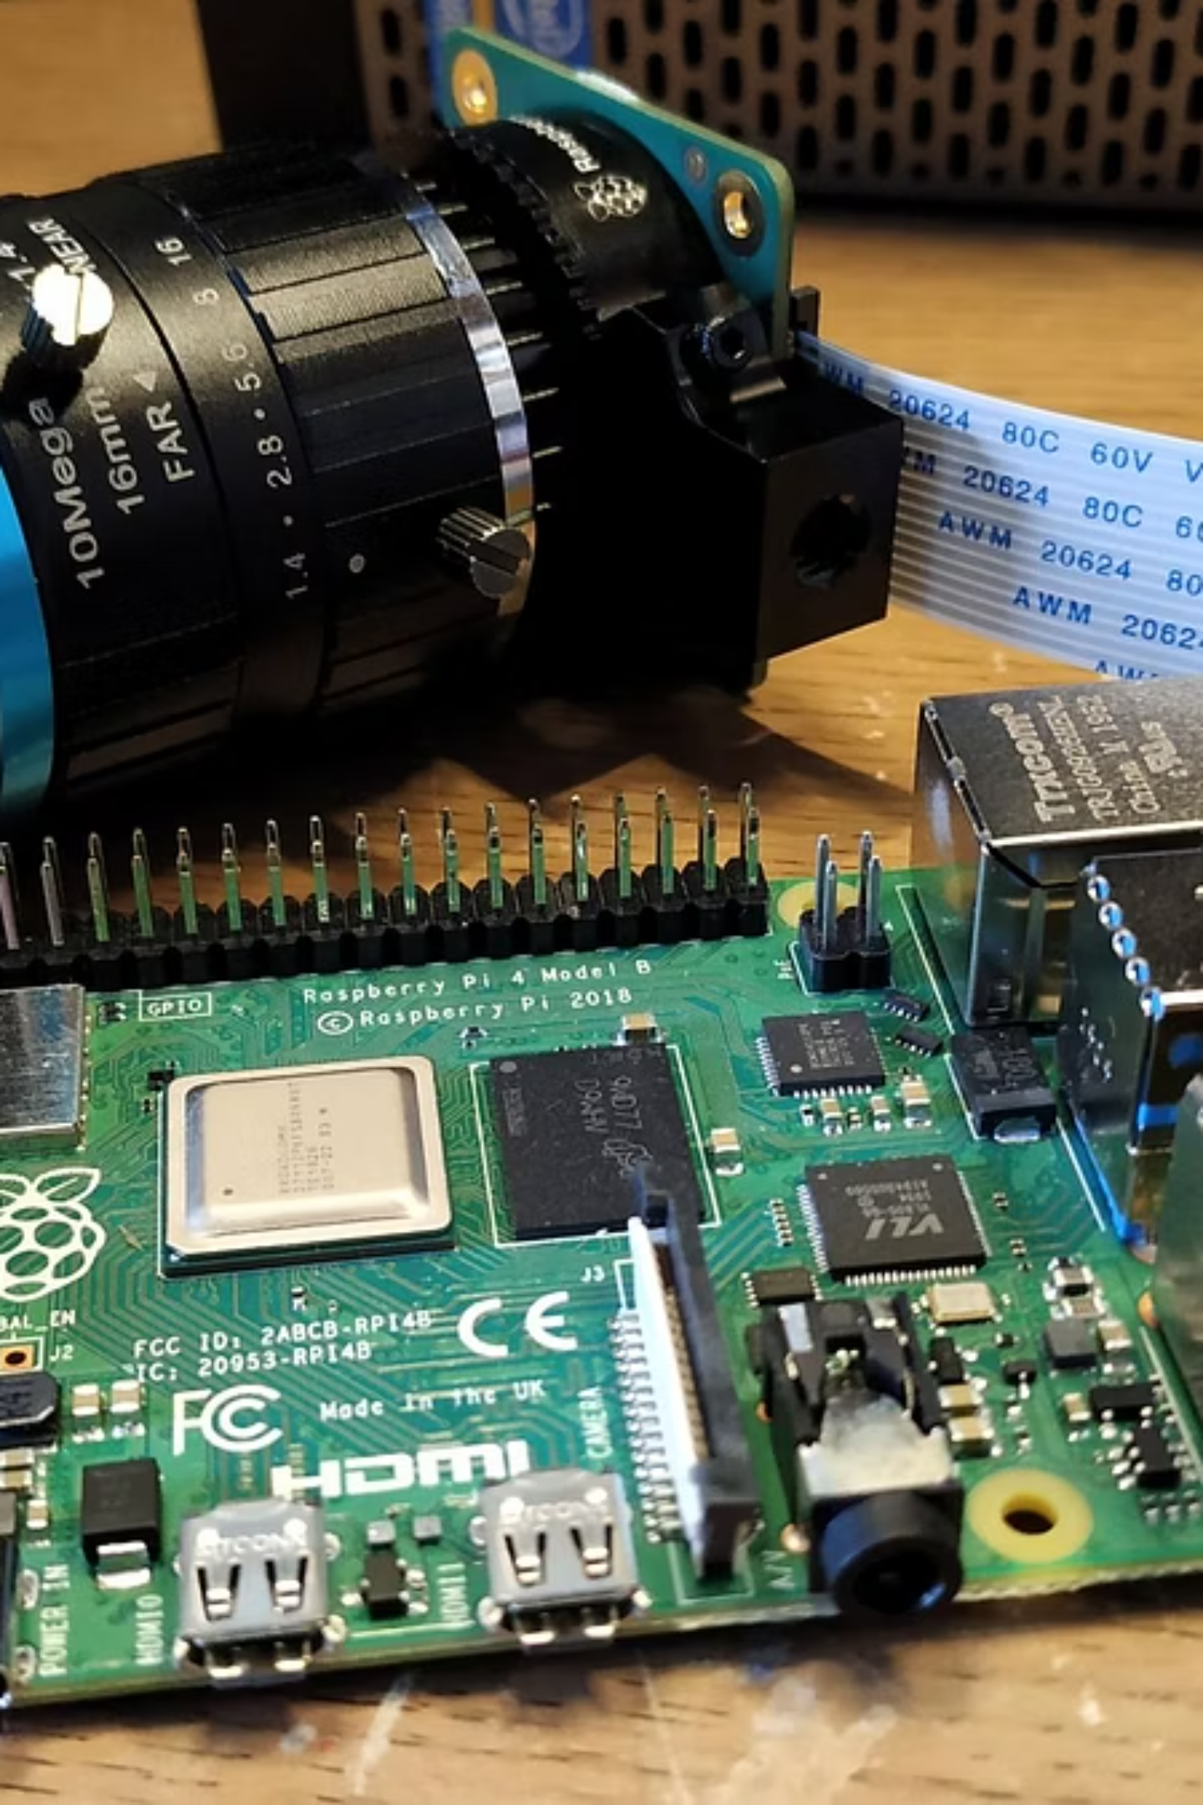




The Smart Trap System
Autonomous Detection Pipeline
Capture
Device photographs insects inside pheromone trap
Extract ROIs
Pre-processing identifies regions of interest using edge detection
Classify
Neural network classifies Codling Moth vs. general insect
Transmit
LoRa modem sends count data (bytes, not images)

Slide 5
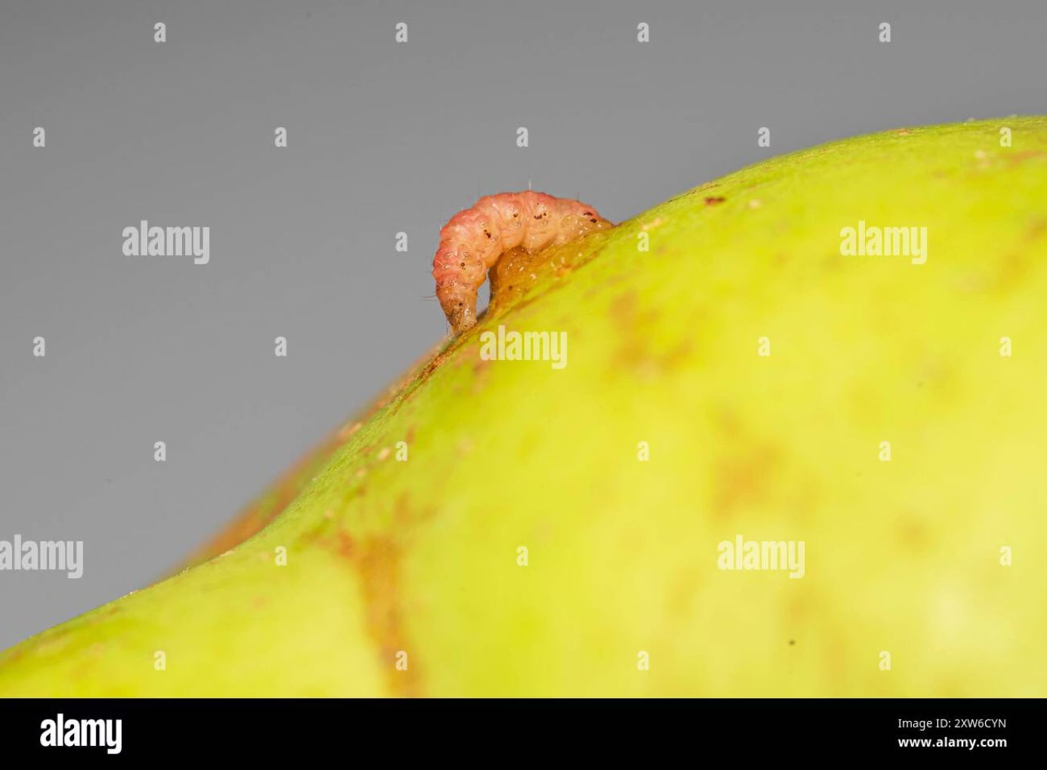
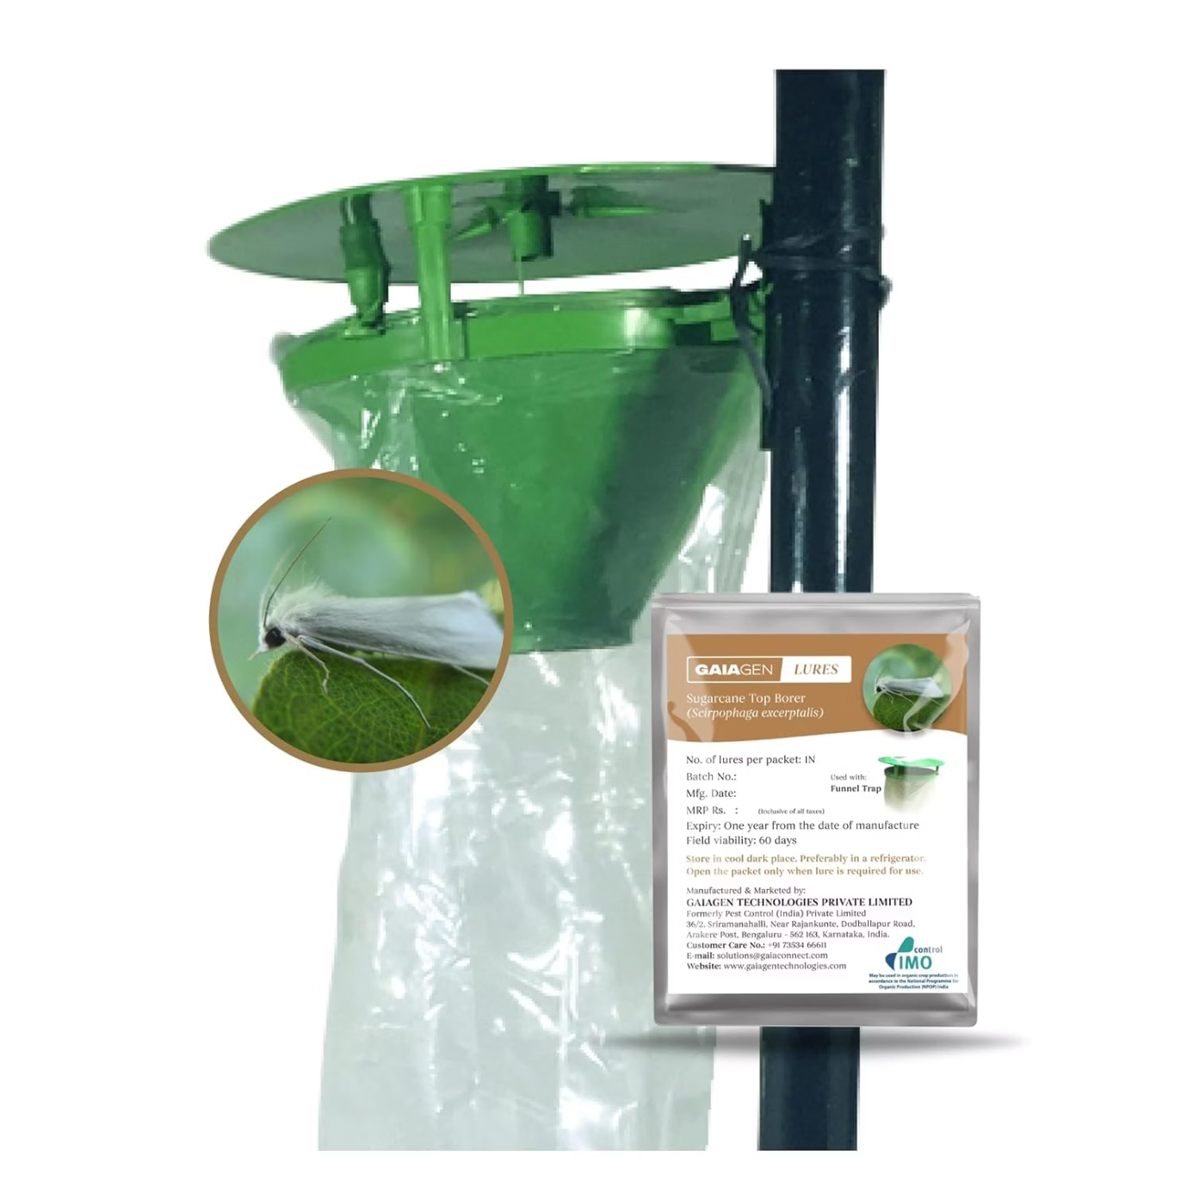
Dataset & Training Methodology
Custom Dataset Construction
1,100 initial images captured from pheromone traps
Data augmentation (shifts, flips, zooms) expanded dataset
4,400 final images: 3,200 Codling Moth, 1,200 general insects
Split: 3,500 training, 900 testing
Evaluation Metrics
Standard classification metrics (accuracy, precision, recall, F-score) plus critical edge-computing metrics: energy consumption and execution time.

Slide 6
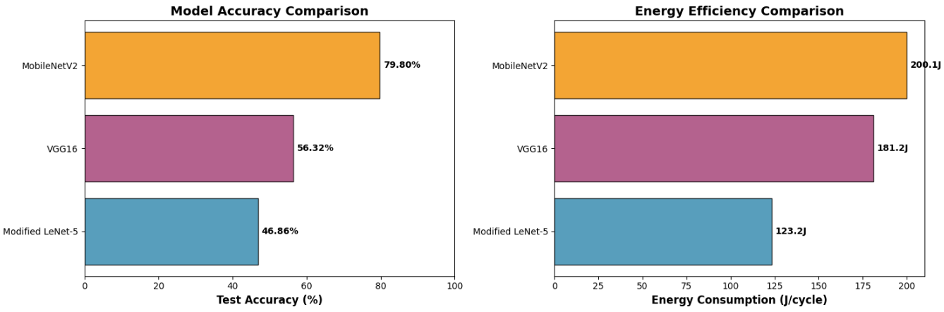
Performance Results
Classification Accuracy
Training Efficiency
Best F-Score
Precision Leaders
VGG16 reached 99.5% validation accuracy in only 8 epochs—significantly faster than LeNet-5 and MobileNetV2, which both required 100 epochs.
VGG16: 98.5%LeNet-5: 97.2%MobileNetV2: 96.4%
Both VGG16 and LeNet-5 achieved exceptional precision of 99.6%, minimizing false positives.

Slide 7




Energy Consumption: The Critical Edge Factor
62%
91%
100%
LeNet-5 Efficiency
VGG16 Cost
MobileNetV2 Surprise
Most energy-efficient at 123.2 J per cycle on RPi3 standalone
High consumption at 181.2 J on RPi3—47% more than LeNet-5
Highest consumption at 200.1 J on RPi4 despite mobile optimization
Winner: RPi3 + LeNet-5 offers the optimal trade-off with 96.1% accuracy and lowest energy consumption. Capable of running 3 months on battery alone and indefinitely with solar harvesting.

Slide 8

Future Directions & Conclusions
Pathways to Enhancement
01
02
03
Robust Field Training
Sensor Fusion for Prediction
Advanced Imaging Modalities
Train on complex in-field images with varying backgrounds, lighting, and textures—not just controlled trap environments.
Integrate environmental sensors (temperature, humidity, leaf wetness) with CNN-LSTM hybrid models to forecast outbreaks before they occur.
Explore thermal imaging to detect plant stress pre-symptomatically, plus Vision Transformers for spatial-temporal analysis.
Key Takeaway
This analysis demonstrates that on-edge deep learning is a practical, sustainable solution for autonomous agricultural monitoring. While VGG16 delivers the highest accuracy (97.9%), the modified LeNet-5 provides the best balance of performance (96.1%) and energy efficiency (123.2 J/cycle) for real-world deployment. The successful prototype validates the transformative potential of precision agriculture technologies to address global food security challenges.

